Slide 1


HOTEL RESERVATION DATASET
TASK-2

Slide 2
DATA CONVERSION:
TO ANSWER THE GIVEN QUESTIONS WE NEED TO CONVERT THE CSV FILE T SQL TABLE
FOR THAT WE NEED TO HAVE A SOFTWARE RELATED TO SQL
OPEN THE SOFTWARE AND CREATE A NEW DATA BASE
NOW FIND THE TASKS BY RIGHT CLICKING ON DATABASE
NOW WE CAN SEE IMPORT FLAT FILE IN THE TASK,CLICK ON IT
NOW SELECT THE GIVEN RESERVATION DATASET AND NAME THE TABLE.I NAMED IT AS Reservation_dataset

Slide 3
DATASET DETAILS:
Booking_ID: A unique identifier for each hotel reservation.
no_of_adults: The number of adults in the reservation.
no_of_children: The number of children in the reservation.
no_of_weekend_nights: The number of nights in the reservation that fall on
weekends.
no_of_week_nights: The number of nights in the reservation that fall on
weekdays.
type_of_meal_plan: The meal plan chosen by the guests.
room_type_reserved: The type of room reserved by the guests.
lead_time: The number of days between booking and arrival.
arrival_date: The date of arrival.
market_segment_type: The market segment to which the reservation
belongs.
avg_price_per_room: The average price per room in the reservation.
booking_status: The status of the booking.

Slide 4
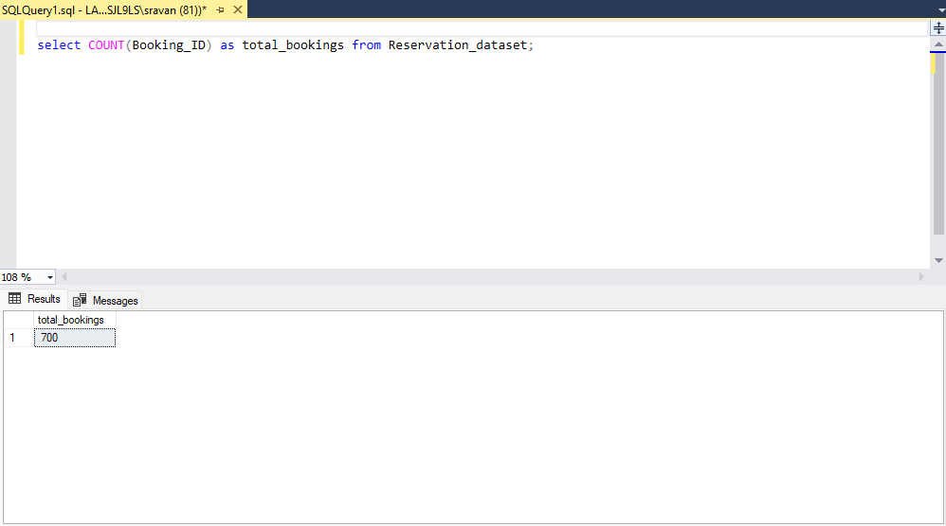
Question_1:What is the total number of reservations in the dataset?
OUTPUT:

Slide 5
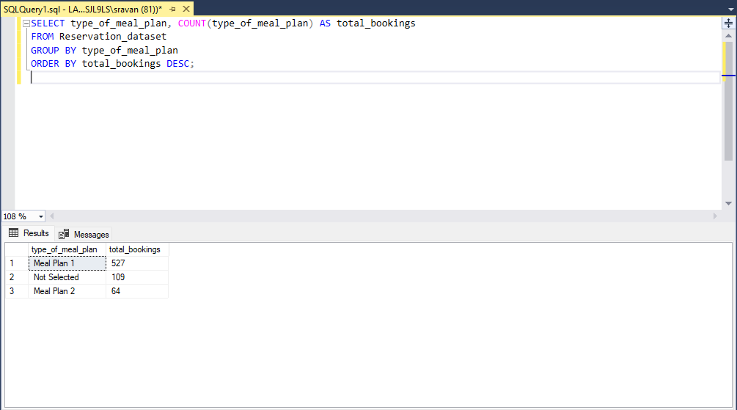
Question_2: Which meal plan is the most popular among guests?
OUTPUT:

Slide 6
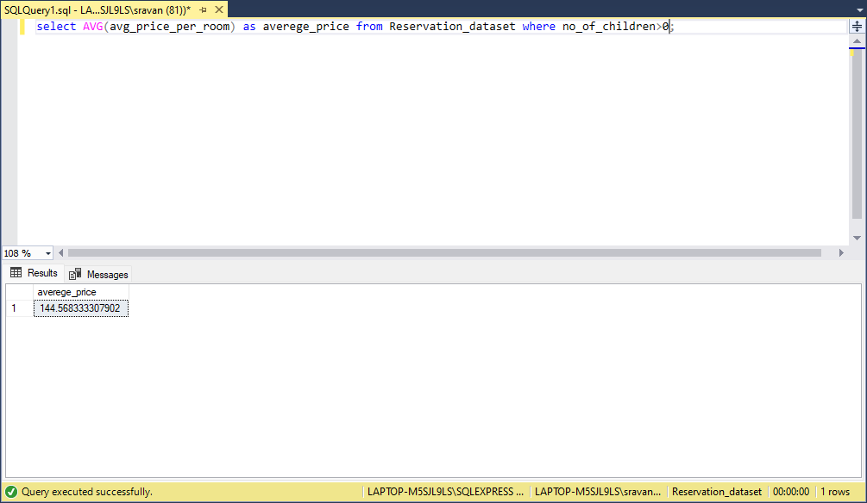
Question_3: What is the average price per room for reservations involving children?
OUTPUT:

Slide 7
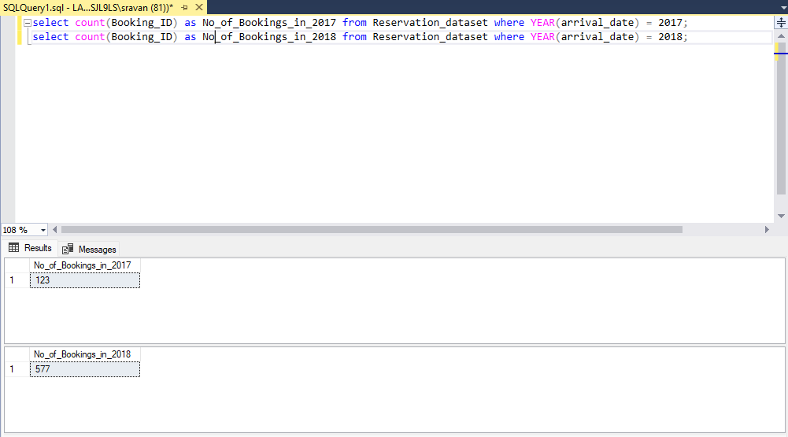
Question_4:How many reservations were made for the year 20XX (replace XX with the desired year)?
OUTPUT:

Slide 8
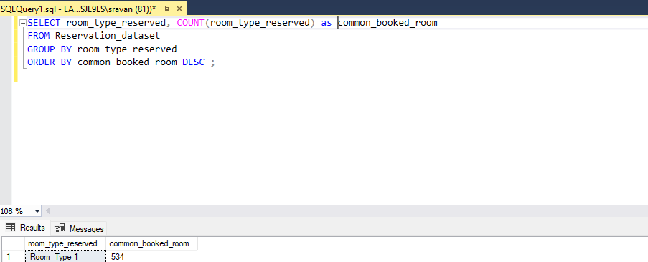
Question_5: What is the most commonly booked room type?
OUTPUT:

Slide 9
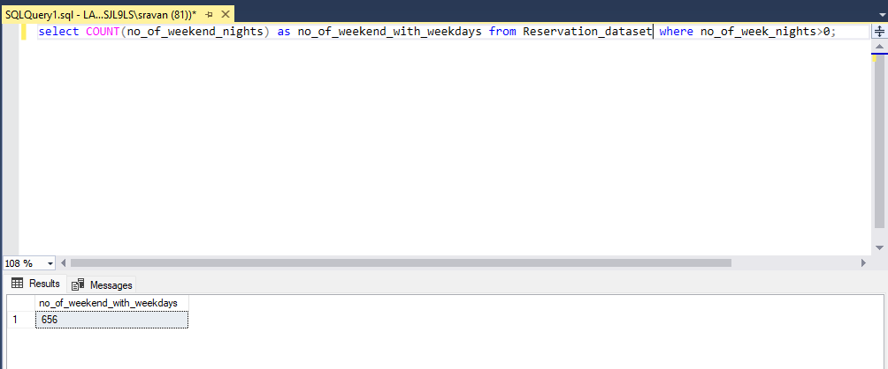
QUESTION_6: How many reservations fall on a weekend (no_of_weekend_nights > 0)?
OUTPUT:

Slide 10
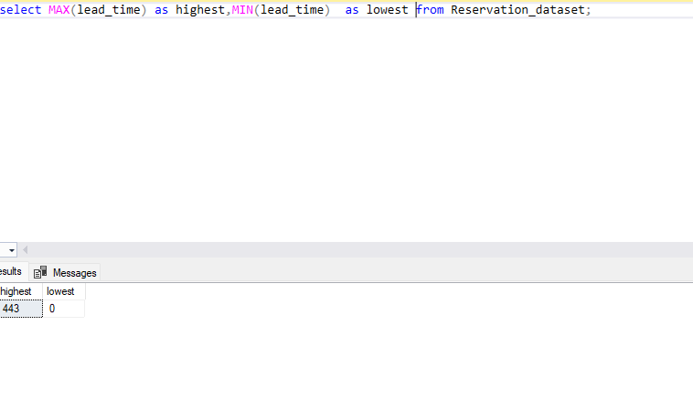
QUESTION_7: What is the highest and lowest lead time for reservations?
OUTPUT:

Slide 11
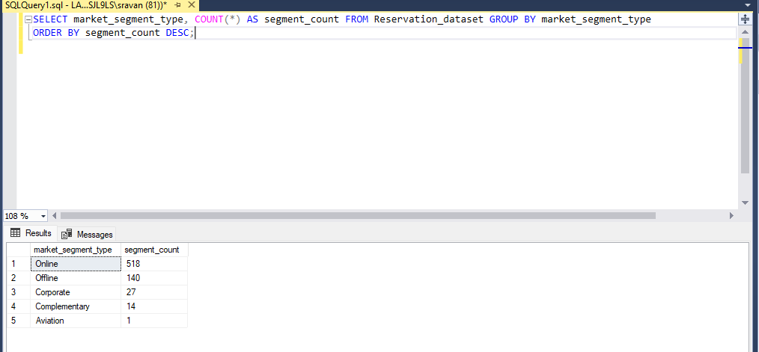
QUESTION_8: What is the most common market segment type for reservations?
OUTPUT:

Slide 12
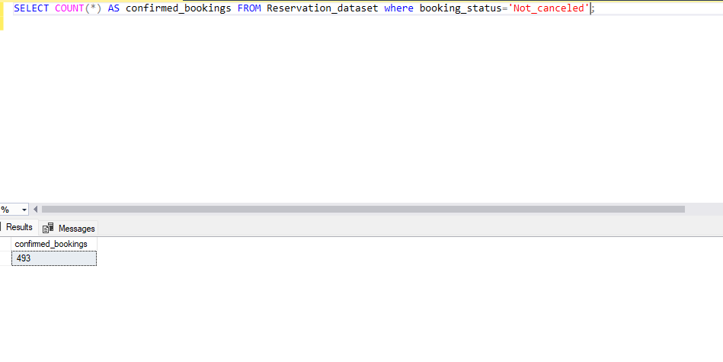
QUESTION_9: How many reservations have a booking status of "Confirmed"?
OUTPUT:

Slide 13
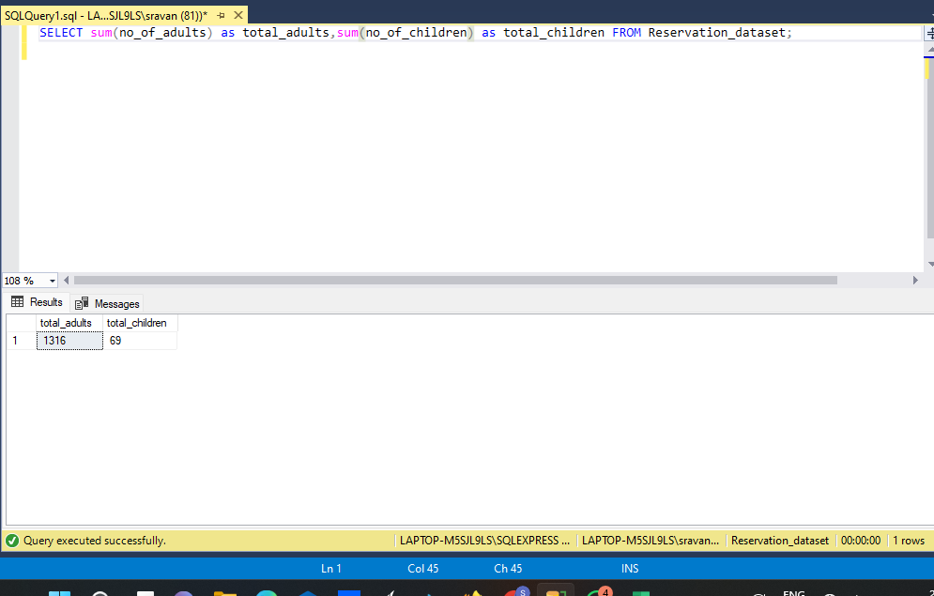
QUESTION_10: What is the total number of adults and children across all reservations?
OUTPUT:

Slide 14
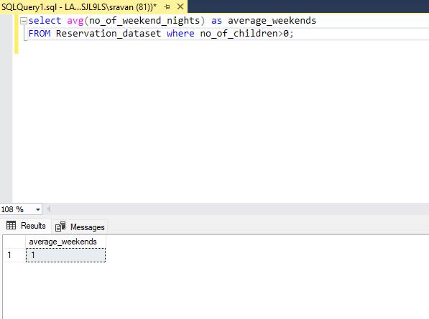
QUESTION_11: What is the average number of weekend nights for reservations involving children?
OUTPUT:

Slide 15
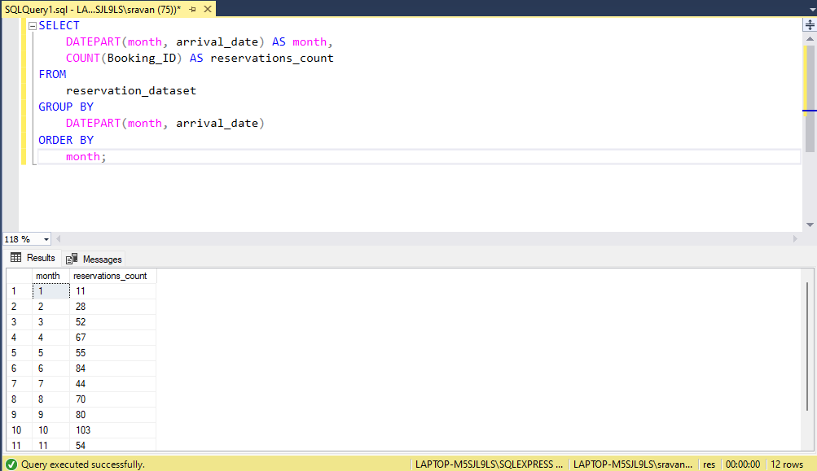
QUESTION_12: How many reservations were made in each month of the year?
OUTPUT:

Slide 16
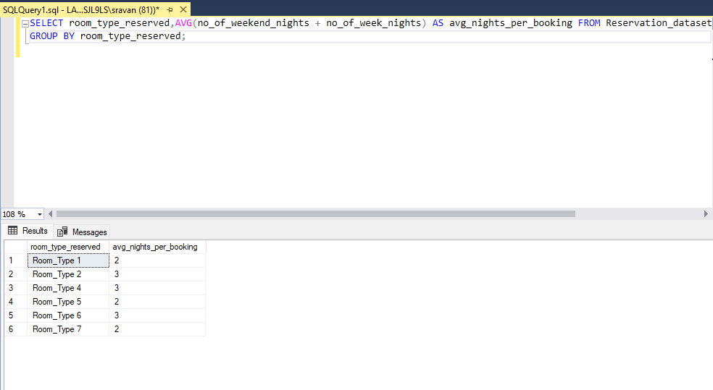
QUESTION_13: What is the average number of nights (both weekend and weekday) spent by guests for each room type?
OUTPUT:

Slide 17
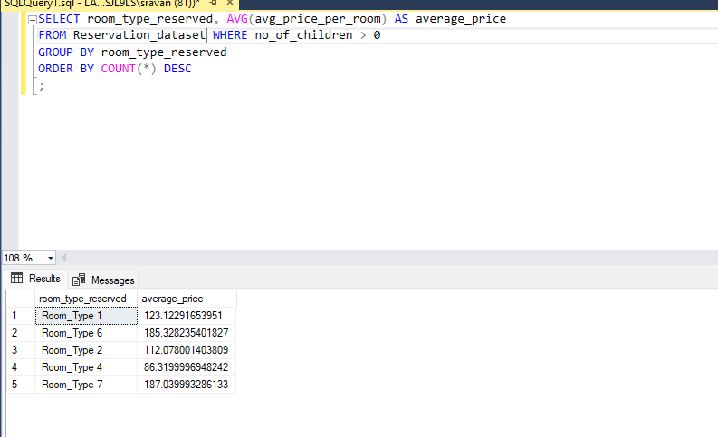
QUESTION_14: For reservations involving children, what is the most common room type, and what is the average price for that room type?
OUTPUT:

Slide 18
QUESTION_15: Find the market segment type that generates the highest average price per room.
OUTPUT:

Slide 19


